Slide 1
Formal education vs Self education
Abhishek Srivastava
19BCE10071

Slide 2
Formal education gives you the fundamentals for doing your job, but the majority of what you learn is theory
Self education is about practical experience where you actually apply knowledge

Slide 3
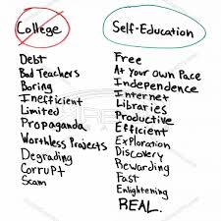
Overview
The growing trend is entrepreneurship. Self education plays a bigger role with entrepreneurs because you must invest in yourself as well as your company.
Once you are able to determine what is your career choice then you can figure out which one will be more advantageous to you

Slide 4
Current Scenario
Most of us are pursuing formal education and simultaneously opting Self Education. Following are the difficulties faced by them:
What Universities and Colleges are teaching is Obselete and superannuated.
Time is Everthing. Universities curriculum is a boredom on, students hardly get few hours to devote in self study.
Most Students are aren’t aware of truth :)
Notes:
Most of us are pursuing formal education and simultaneously opting Self Education. Following are the difficulties faced by them:
What Universities and Colleges are teaching is Obselete and superannuated which is not even used in ongoing tech projects as over the period of time, better tech stack is introduced for developers.
Time is Everthing. It’s quite obvious that Self Education is must (with or without formal education) , but the harsh reality is that students aren’t able to pursue that. Universities curriculum is a boredom on, students hardly get few hours to devote in self study.
Most Students are aren’t aware of this. They keep following what colleges teaches them, gets good grades, and end up in not so good state. (we all are aware of current scenario of employment in our country). I won’t blame students for this, they followed everything they were told :)

Slide 5
So which is better,
Formal education or Self education ?

Slide 6
THANK YOU

